Slide 1
Unpaired Image-to-Image Translation using Cycle-Consistent Adversarial Networks (Zhu, J.Y., et al. Proceedings of the IEEE international conference on computer vision. 2017) Boostcamp AI Tech Sang-hyun Kim
Notes:
Impact factor 10.12

Slide 2
목차
사전 지식
GAN
pix2pix
Abstract
Introduction
Formulation
Adversarial Loss
Cycle Consistency Loss
Full Objective
Training Details
Result
Limitation and Conclusion

Slide 3
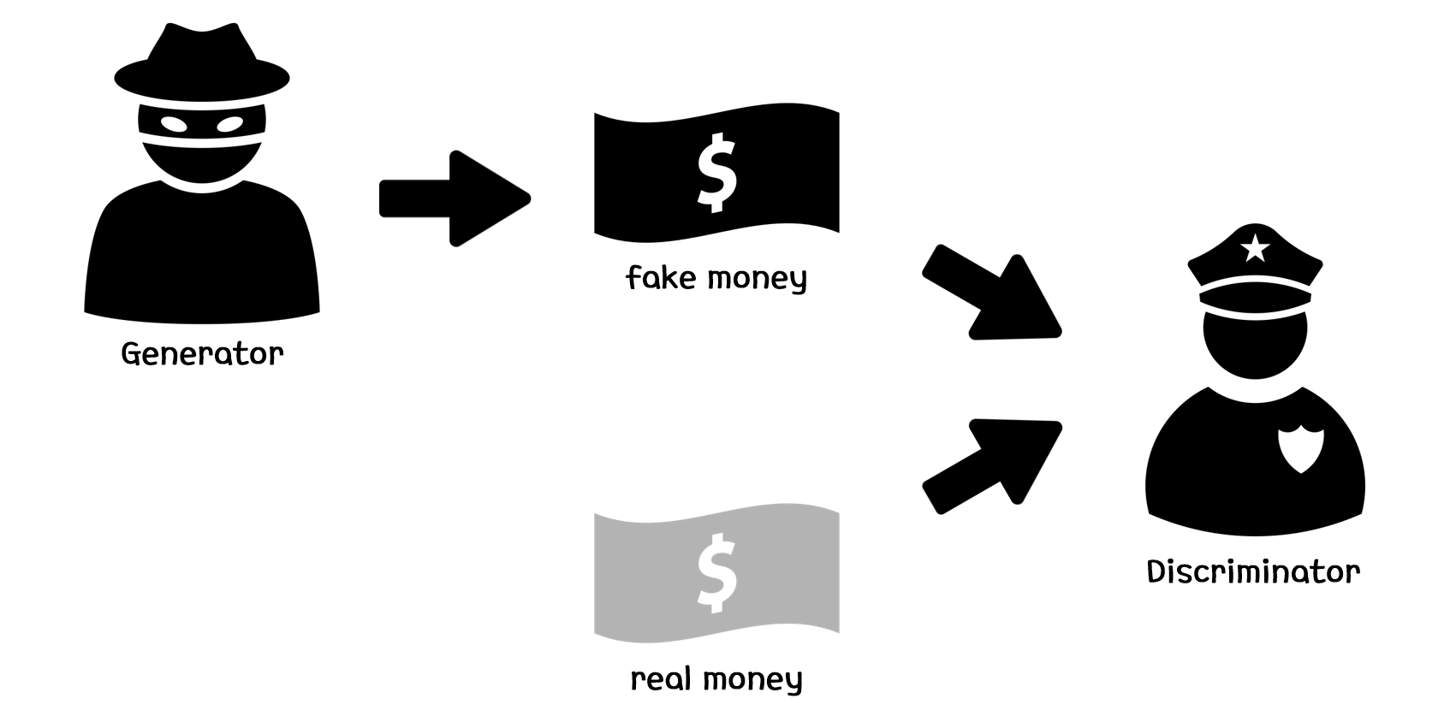
사전 지식 - GAN
Overview

Slide 4
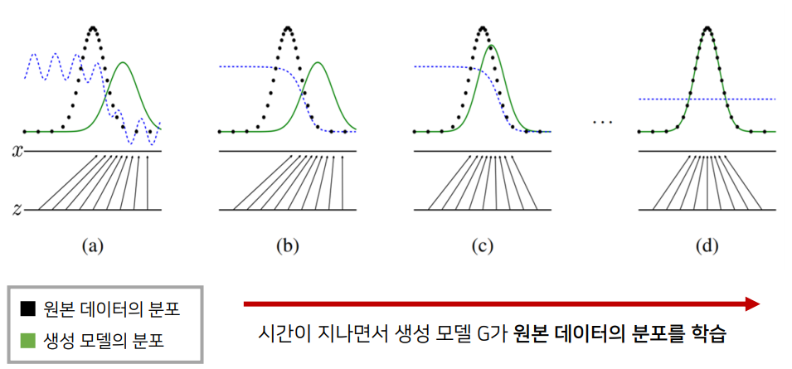
사전 지식 - Generative Model의 목표
모델 G는 원래 데이터의 분포를 근사할 수 있도록 학습

Slide 5

사전 지식 - GAN Loss
Loss function

Slide 6
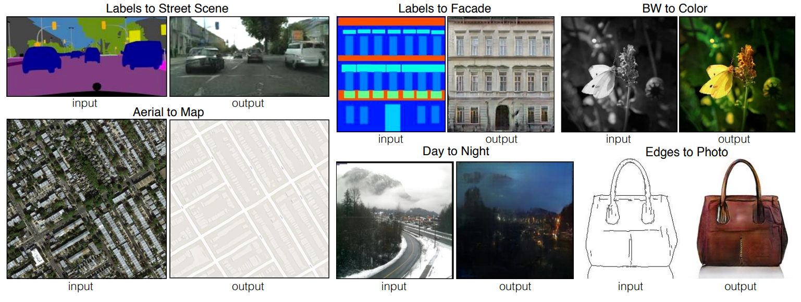
사전 지식 - pix2pix
Overview
Notes:
Pix2pix : Pixel을 다른 pixel로 바꿔준다는 뜻

Slide 7
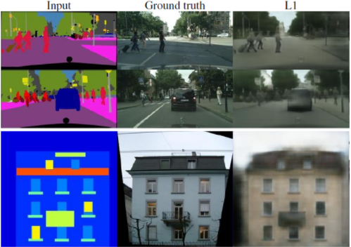
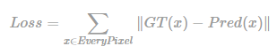
사전 지식 - pix2pix
ONLY!!! L1 Loss
Notes:
Pix2pix : Pixel을 다른 pixel로 바꿔준다는 뜻, pair input
어떤 색을 칠할지 몰라 Photo-realistic 하지 않다!!

Slide 8
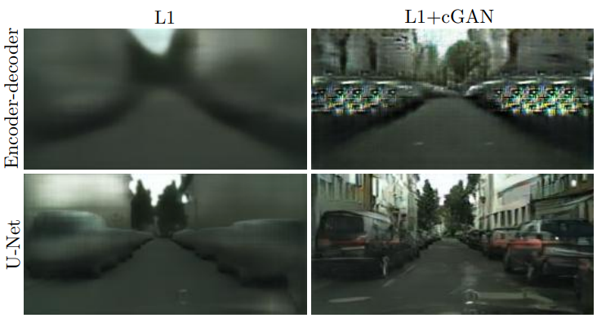

사전 지식 - pix2pix
Let’s use GAN loss
GAN loss
Reconstruction loss
Notes:
GAN loss를 사용하면 더 그럴듯하게 만들 수 있지 않을까?
U-Net, PatchGAN 언급.

Slide 9
사전 지식 - pix2pix
Goal
GAN: Parameter → Image.
pix2pix: Image → Image.
BUT!! Input과 Output은 항상 pair!!!

Slide 10
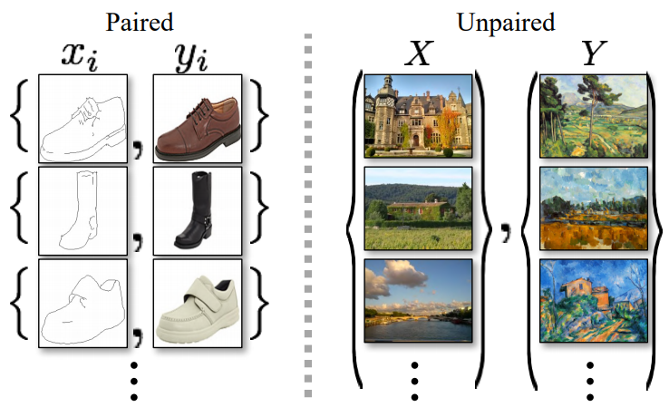
Abstract
Problem
for many tasks(image-to-image translation), paired training data will not be available.
So…
Unpaired image-to-image translation using cycle-consistent adversarial network → CycleGAN

Slide 11
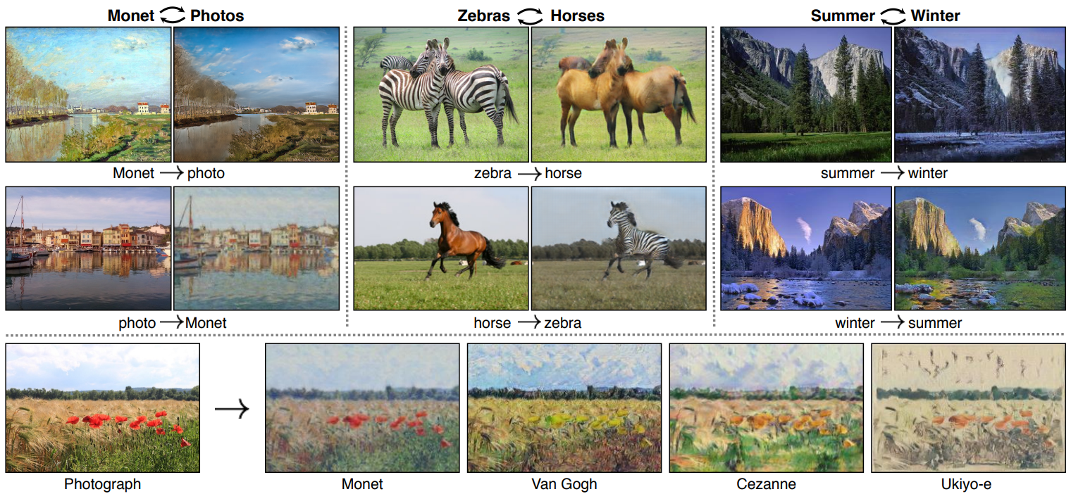
Introduction
Q. What did Claude Monet see as he placed his easel by the bank of the Seine near Argenteuil on a lovely spring day in 1873?

Slide 12
Introduction
A1. We have knowledge of the set of Monet paintings and of the set of landscape photographs.
A2. We can reason about the stylistic differences between these two sets, and thereby imagine what a scene might look like if we were to “translate” it from one set into the other.
→ 따라서, 한 image collection의 특수한 특성을 다른 image collection으로 변환 할 수 있다.

Slide 13
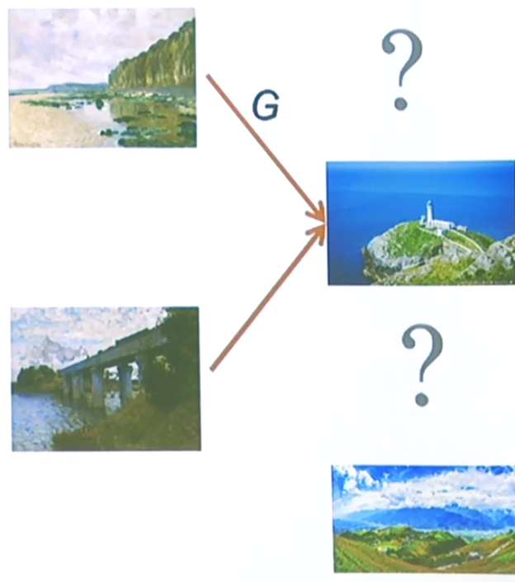
Formulation – Adversarial Loss
단순히 G만 사용을 한다면…
Input image 무시
어떠한 input image가 들어오던지 같은 output image 출력. → Mode Collapse

Slide 14
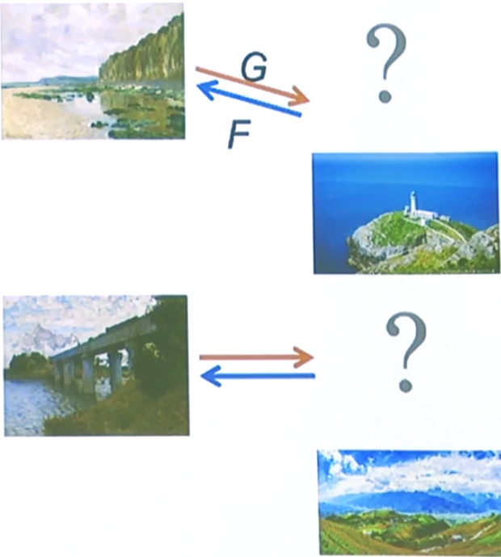
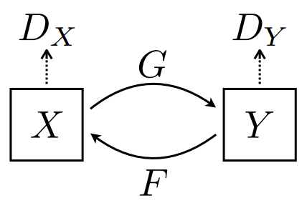

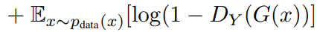
Formulation – Adversarial Loss
Monet paintings
landscape photographs

Slide 15
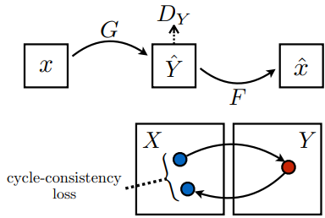
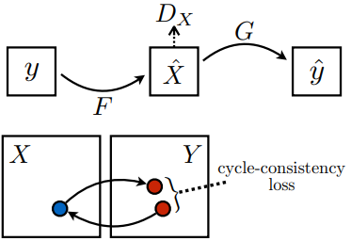
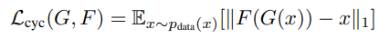
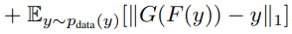
Formulation – Cycle Consistency Loss

Slide 16
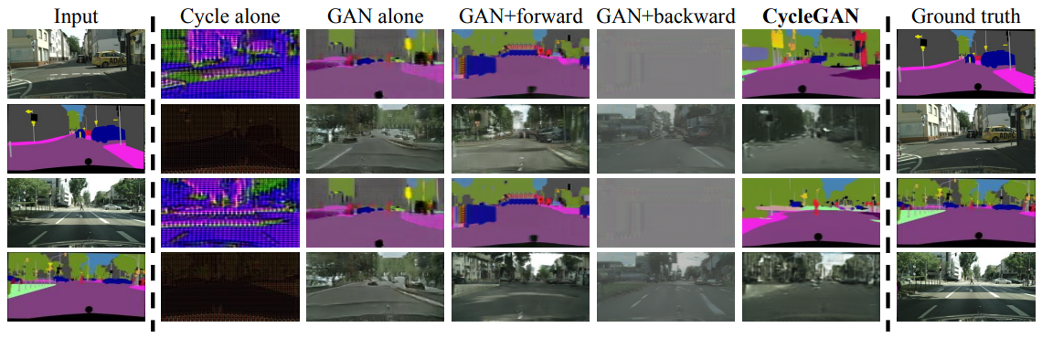
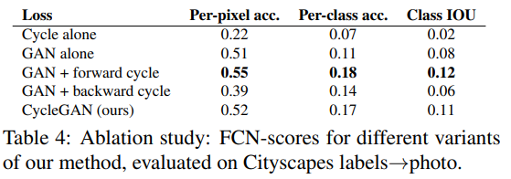
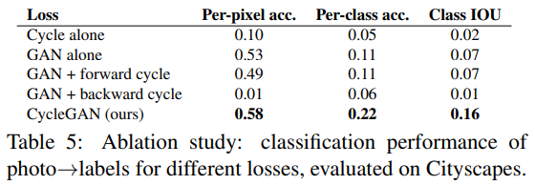

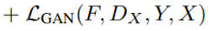
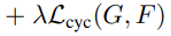
Formulation – Full objective

Slide 17
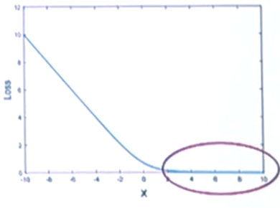
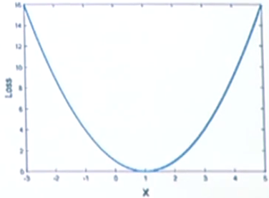

Training details
$L_{GAN}\left(G, D_{Y}, X, Y\right)= 𝔼_{y\sim P_{data}\left(y\right)}\left[logD_{Y}\left(y\right)\right]+𝔼_{x\sim P_{data}}\left(x\right)\left[log{(1−D}_{Y}\left(G(x)\right)\right]$
Vanishing gradient
$L_{LGAN}\left(G, D_{Y}, X, Y\right)= 𝔼_{y\sim P_{data}\left(y\right)}[{\left(D_{Y}\left(y\right)−1\right)}^{2}]+𝔼_{x\sim P_{data}}\left(x\right)\left[{D_{Y}\left(G(x)\right)}^{2}\right]$
Least square GANs
Stable training + better result.

Slide 18
Result
Evaluation metrics
AMT perceptual studies
사람을 대상을 한 실험
FCN score
기존의 Fully convolution network와 비교
Semantic segmentation metrics
Per-pixel accuracy, IOU 등의 평가지표

Slide 19
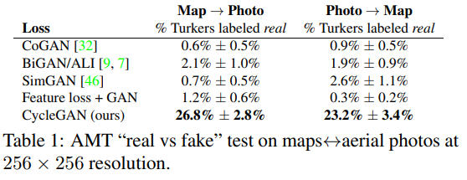
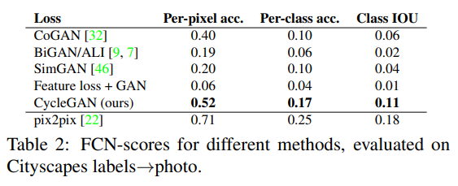
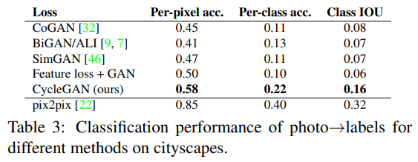
Result

Slide 20
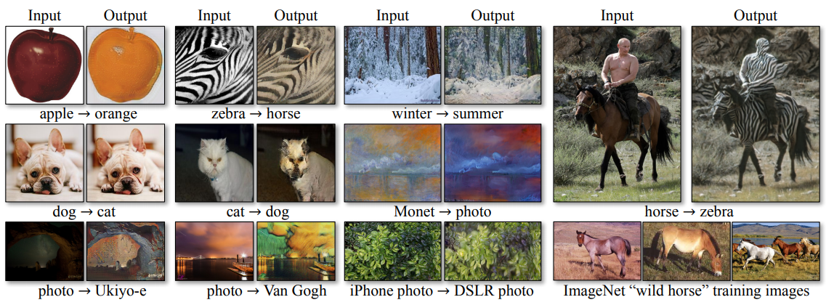
Limitations and Discussion
참고: https://arxiv.org/pdf/1406.2661.pdf

Slide 21
Reference
GAN: https://arxiv.org/pdf/1406.2661.pdf
Pix2pix: https://arxiv.org/pdf/1611.07004.pdf

Slide 22
THANK YOU!!!

